Slide 1
Topic 1 – Intro to Data Science for Business
Statistics and Data Analysis
COR1-GB.1305
Prof: Chris Volinsky
NYU Stern: Spring 2024

Slide 2

Why Data Science?
[image of a data scientist in a business environment – Dall-E ]
Notes:
Why data science
What are the uses of data science in your fields? Or cool applications of data science you hope to learn about…

Slide 3

What do you hope to get out of this course?
[make her more successful]
Learn the basics of data science
Practical implications of data
Refresh coding skills
Interpreting and communicating data
Learn more about python
Manipulate data sets to form helpful conclusions
Applications for business
Fulfill graduation requirement

Slide 4

Class Goals
Approach business problems data-analytically
Understanding of different types of data science problems and approaches
Appreciation of the full range of the data science process
Hands on experience with data science tools and algorithms (using Python)
Design potential solutions to real business problems
[Professor teaching data science to business students]
Expectations:
Basic statistical knowledge
Mean v median, spread
Variation, sampling
Ability to read statistical graphs
Basic python knowledge

Slide 5
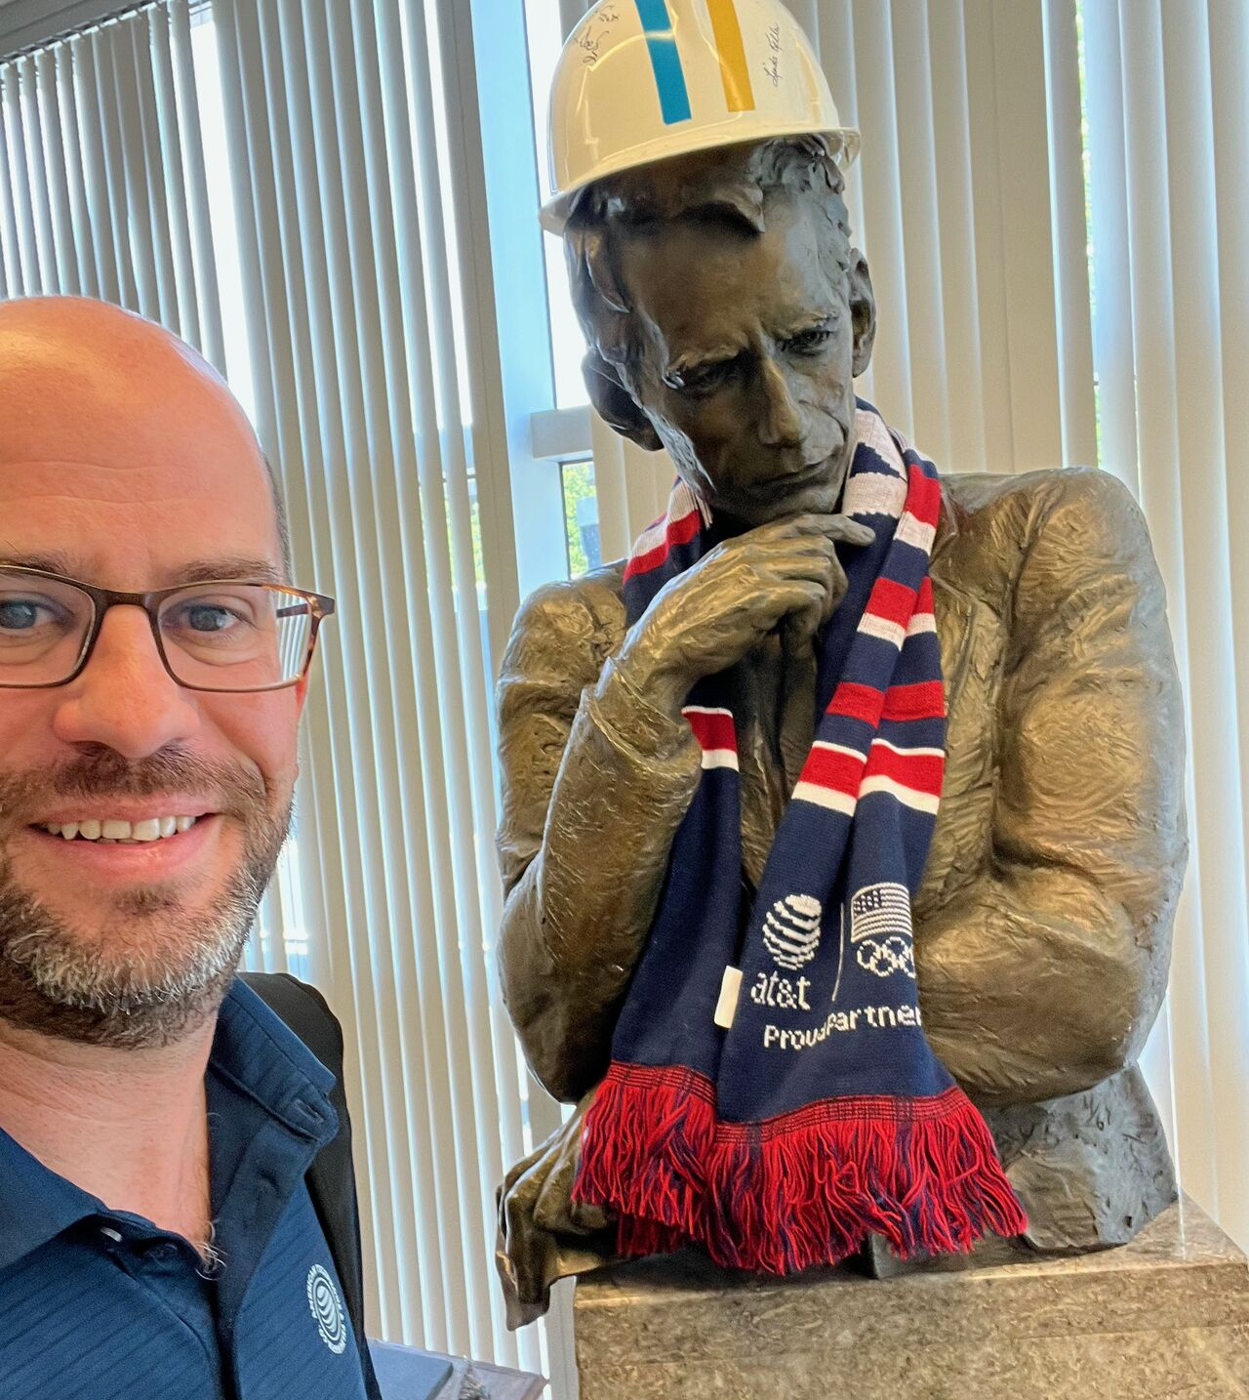
About Me
Information is the resolution of uncertainty.
- Claude Shannon, AT&T Bell Labs
The best part about being a statistician is you get to play in everyone’s backyard.
- John Tukey, AT&T Bell Labs

Slide 6
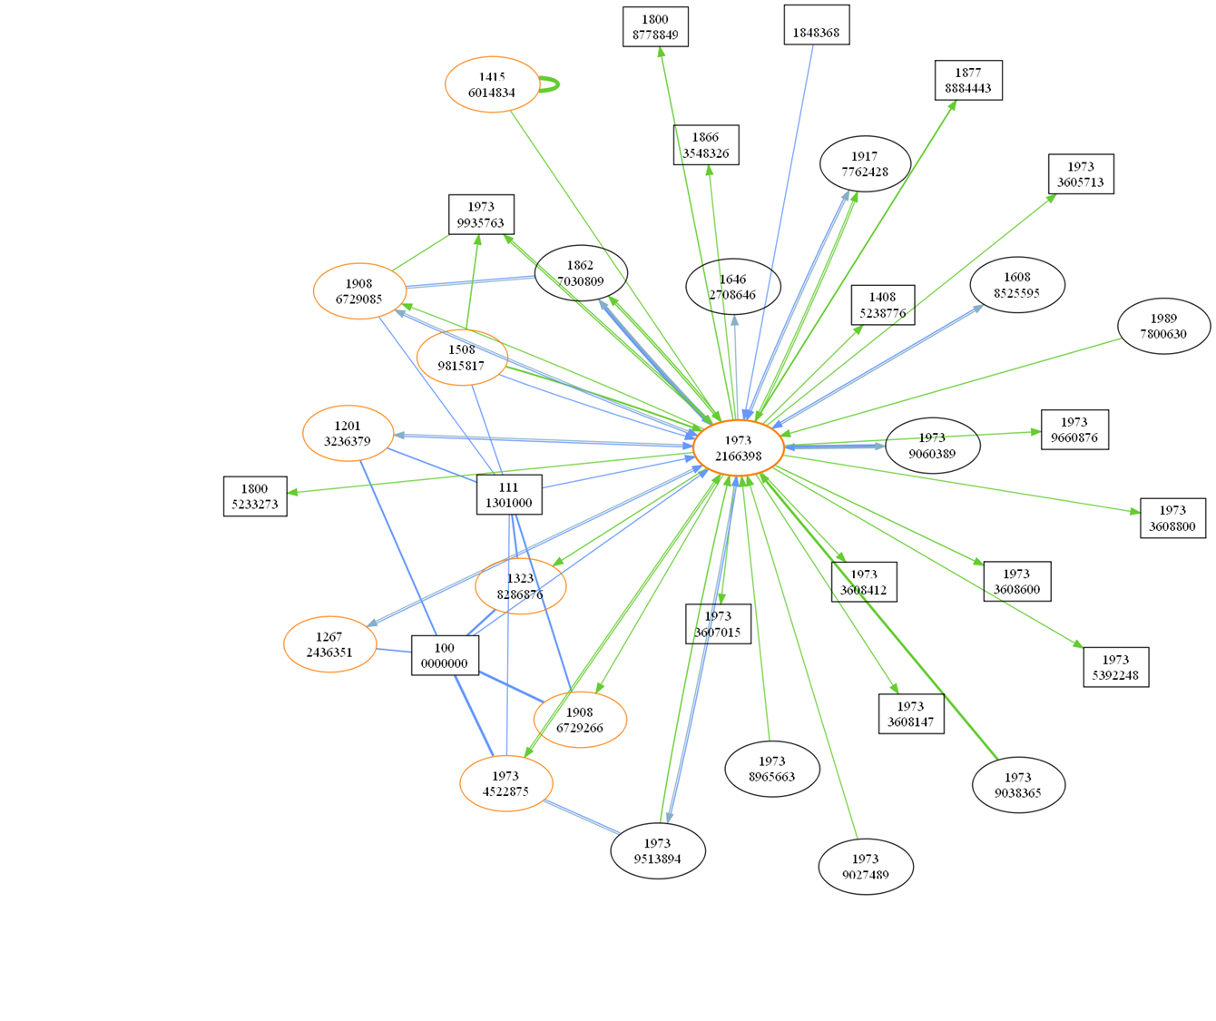
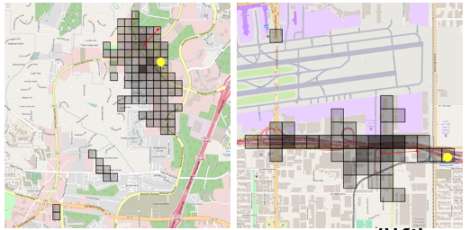
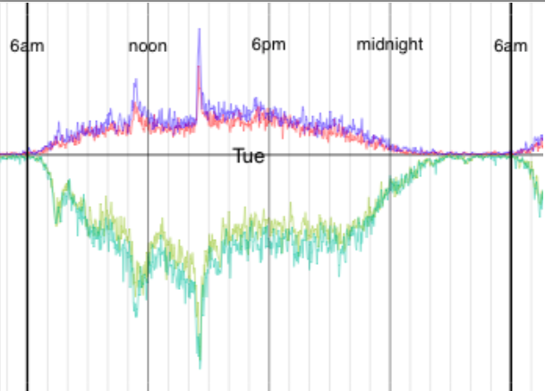
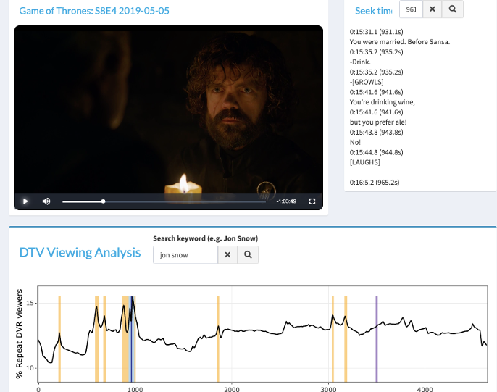
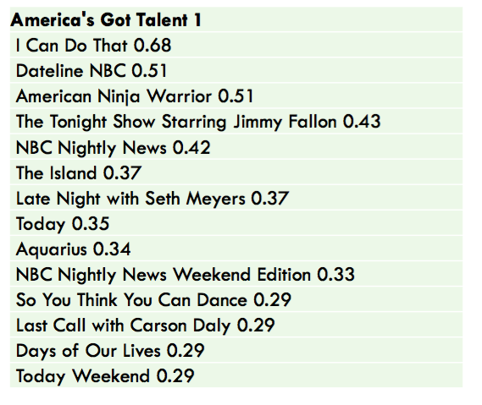
Data Science Projects
Network analytics
Social Networks and Marketing
Content Recommender Systems
TV and Video Consumption
Notes:
i worked in the research arm so had some fr eedoms
Also fraud and churn

Slide 7
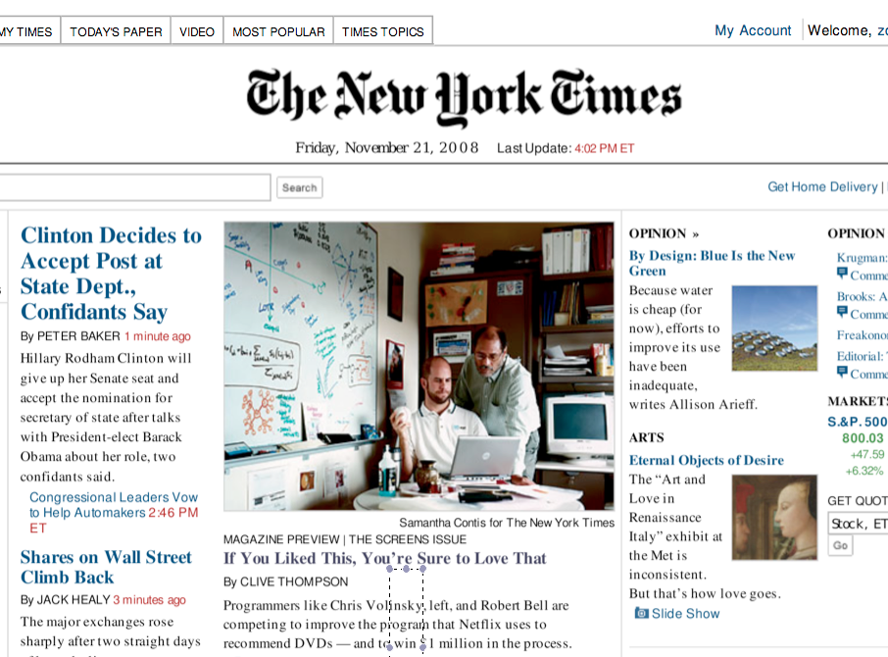
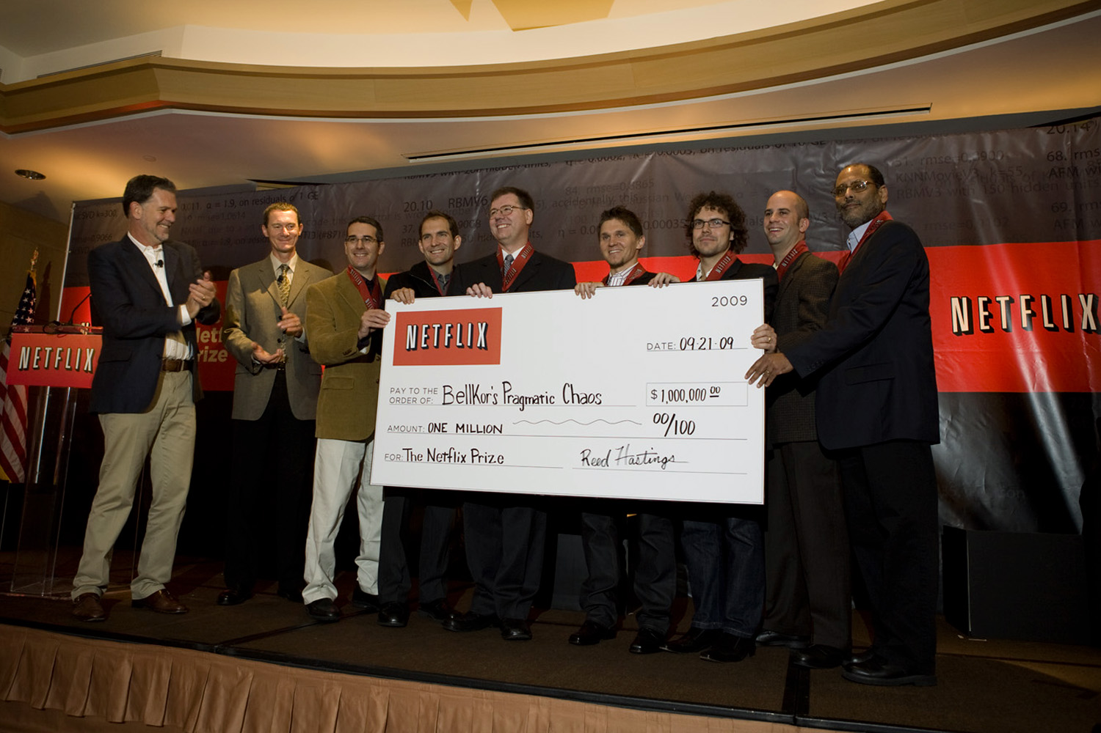
Netflix Prize
An example of data science transforming a business

Slide 8
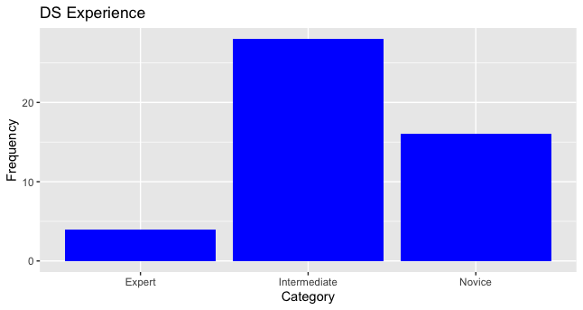
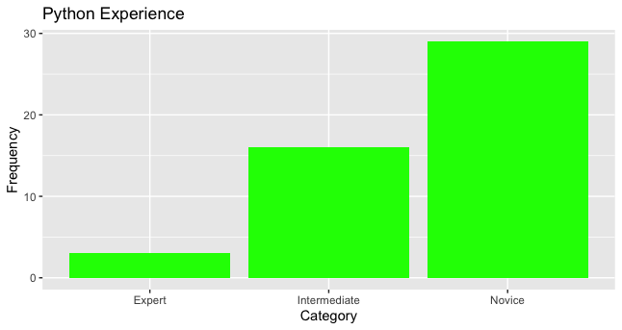
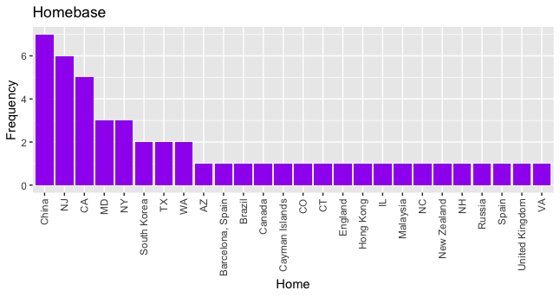
About you…
N=48

Slide 9
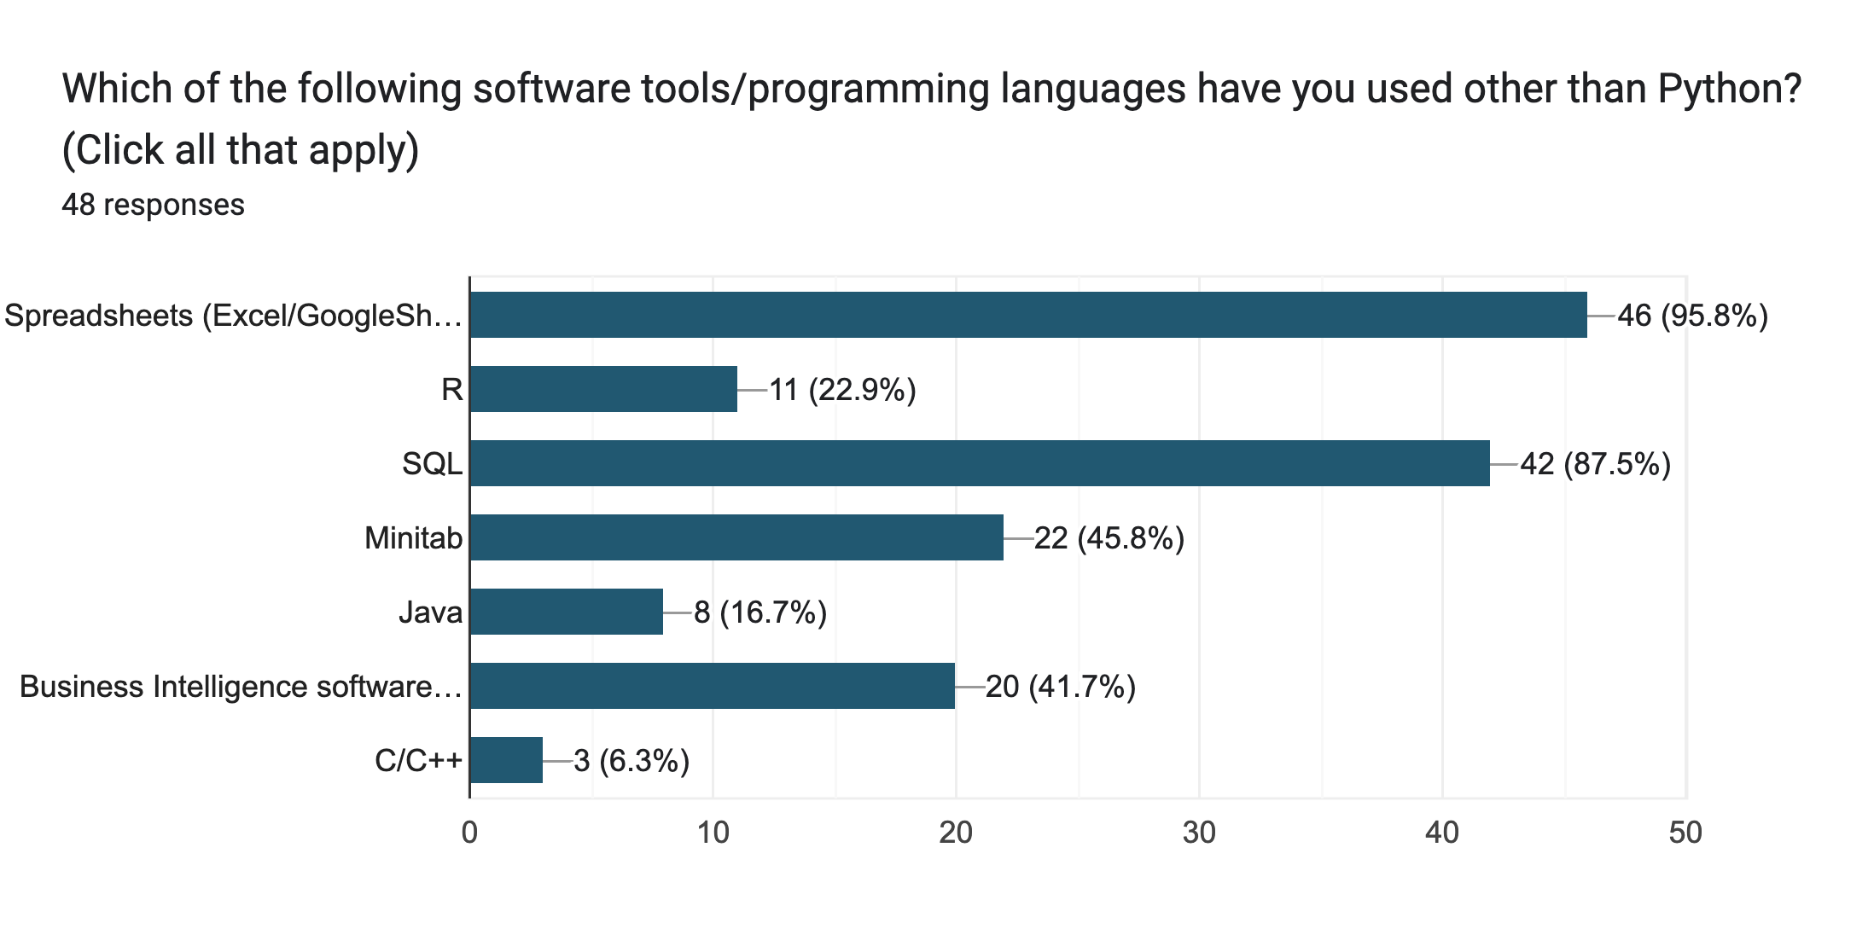
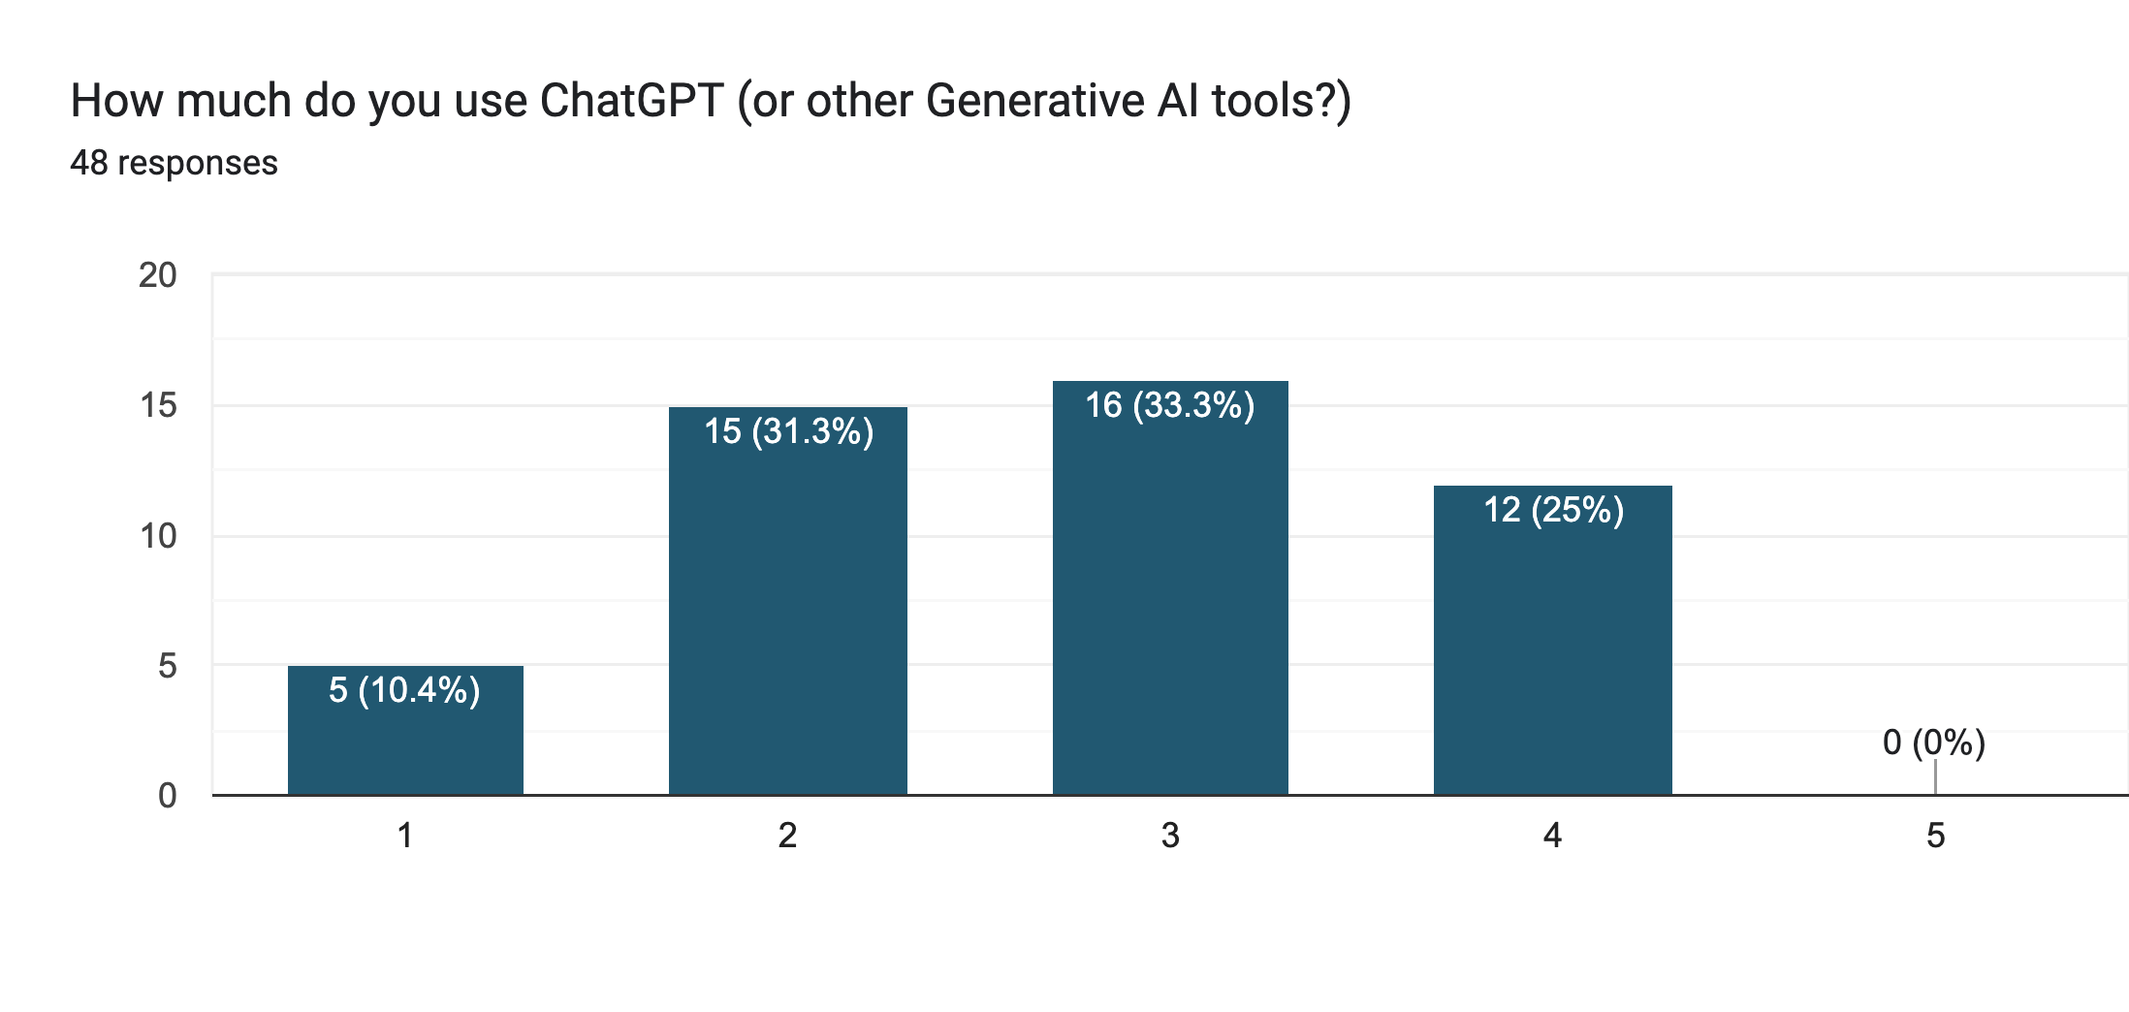
Writing / Proofreading | 56%
Summarizing Text / Articles | 60%
Search Engine / Wikipedia | 37%
Writing/ Debugging Code | 29%
Help with Homework | 17%
Media / Image Creation | 15%

Slide 10
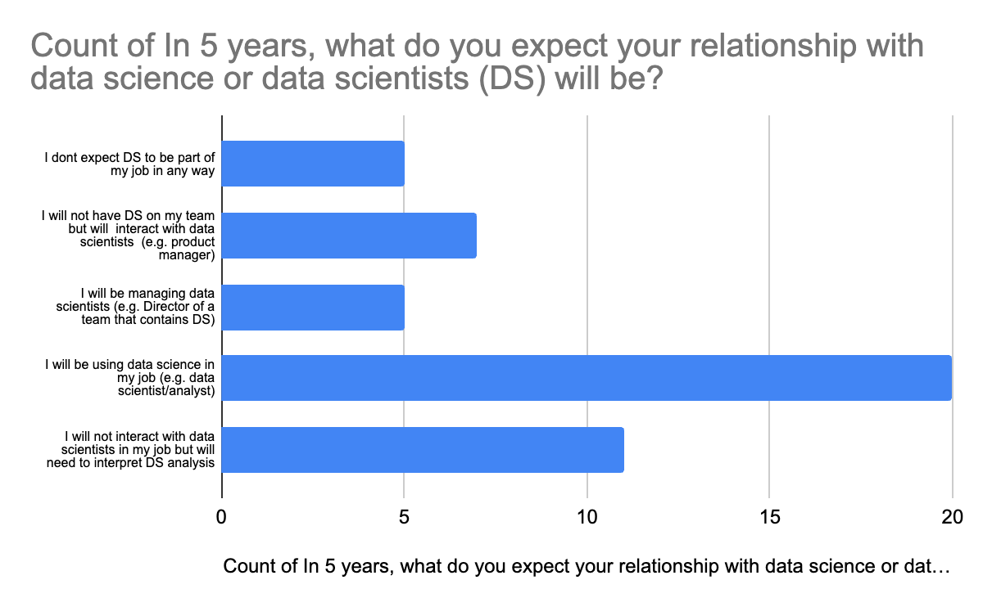

Slide 11
About this class…

Slide 12
What this class is not
Advanced math – there will be some formulas, but nothing too fancy
Algorithms – what they mean, how to use them, but not how to write or derive them
Advanced Python – you need to know python, but not at a high level
Statistics/Machine Learning – there will be components but there are other classes for that.
Data Engineering or Data Processing: these are important topics and even necessary for DS to know, but beyond the scope of this class

Slide 13

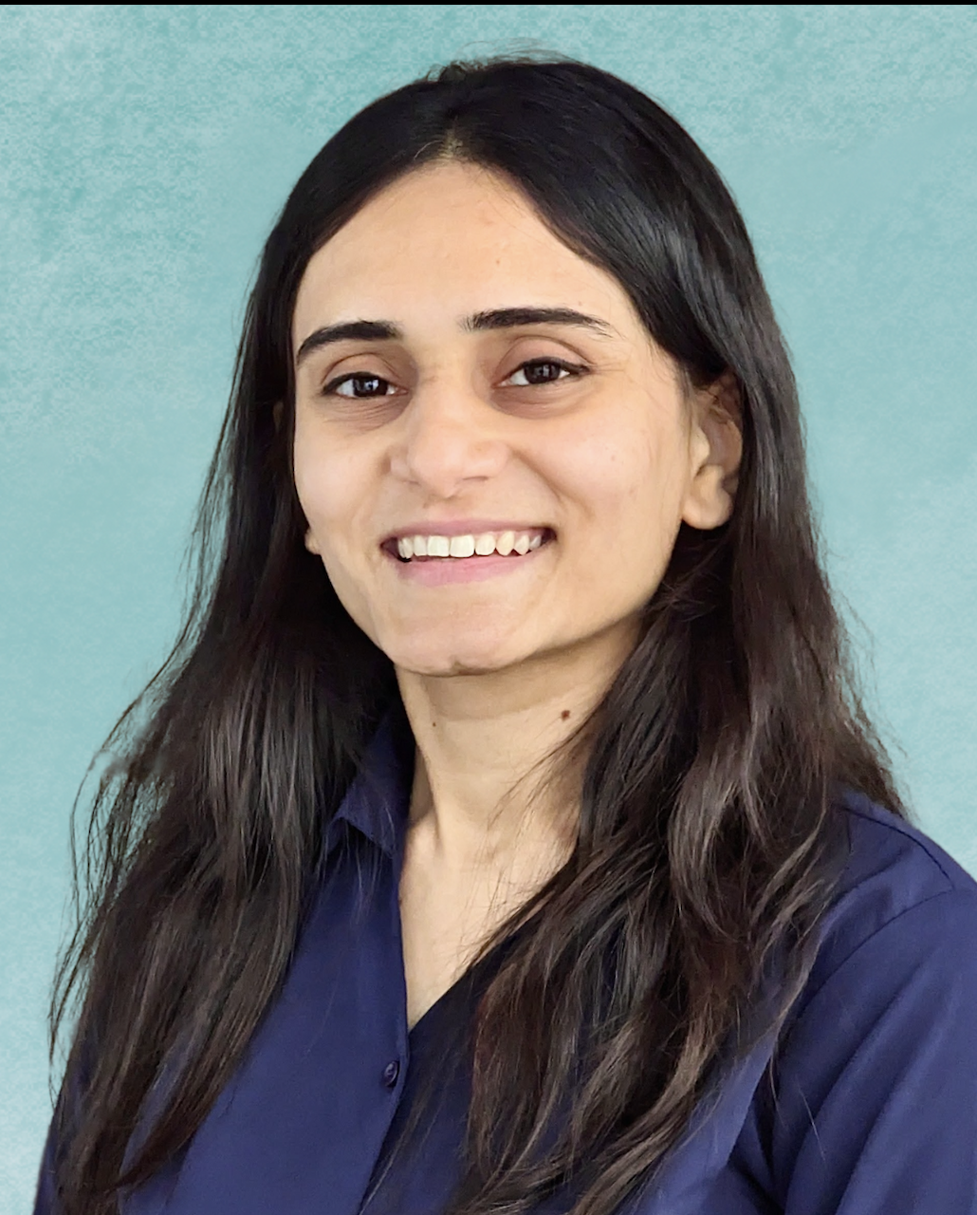

About the Class
Brightspace, Brightspace, Brightspace!
Meet your TA team:
Stuti Mishra
Section 1
Krutika Savani
Section 2
Aditya Deshpande
Section 30 (grad)
Slides to be posted before class (sometimes just before!)
In-class rules
Attendance will be taken
If unavoidable miss of class, catch up via video (BS=>Content=>Mediasite)
Bring laptop! (but only use for class-related items!)
You may get called on randomly … be prepared

Slide 14
Communication
Office Hours
Stuti (UG-1) : Th 3-4
Krutika (UG-2) : W 6-7
Aditya (Grad-30): Th 1-2
Prof V : Tu 6-7; W 2-3
Can use any OH but start with your assigned TA!
Python/HW questions should start with TA
Course/Project questions can come to me
Let us know if you are coming to office hours
If you have a general question about the work / HW / exam question / project, please post it on the Brightspace Discussion Section.
If you have a question, chances are someone else does!
TA’s and I will be monitoring it and will reply promptly

Slide 15

Lets talk about Python
You don’t need to be an expert, but you do need to know your way around
Work through the introductory notebooks this week – as laid out in HW0.
if you have trouble at this level this is not the class for you.
Colab will be what we use in class – but for HW, projects, you may use other IDEs.
Must be able to upload your work as a .ipynb file.
Pro Tip : Save all notebooks to your own Google Drive!!!
HW0:
- Colab_Basics
- Jupyter Notebook
- Python Basics

Slide 16
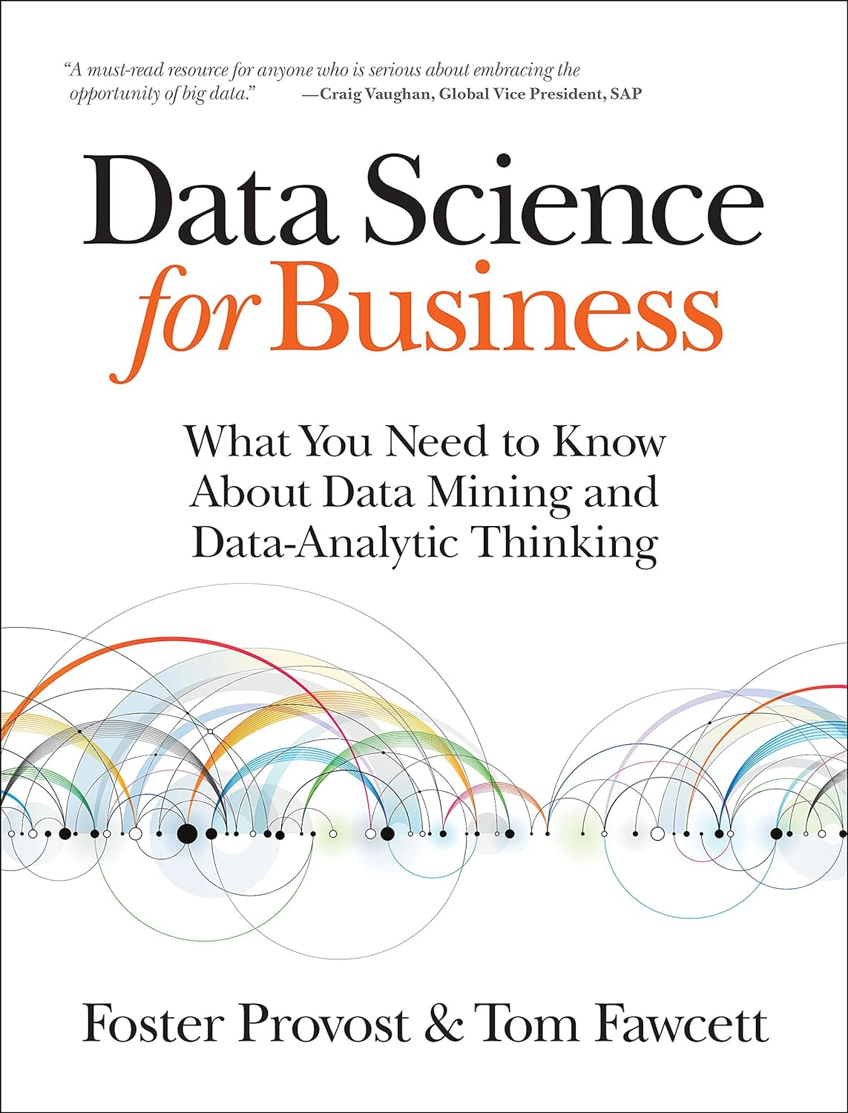

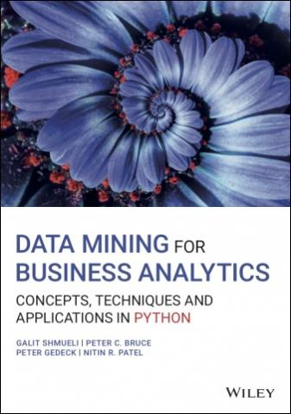
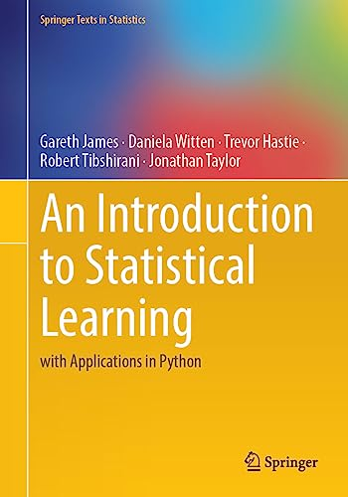
Textbooks
Required Text: Data Science for Business [DSB]
Provost*, Fawcett
Digital version available at bookstore
Can purchase physical copy at Amazon (1st ed)
Main text – data analytic thinking, business context
Optional Texts (all freely available – see syllabus)
ntroduction to Statistical Learning
An Introduction to Statistical Learning (with applications in Python) [ISLP]
James, Witten, et al
More technical, deeper topics, python code
Data Mining for Business Analytics (with applications in Python) [Shmueli]
Lots of good examples and code
OpenIntro to Statistics [OpenIntro]
Statistics refresh
interesting data examples
*NYU Stern prof

Slide 17
Grades
HW (3) 30%
Assigned and collected in Brightspace
Late HW:
25% reduction < 24 hr
50% reduction < 72 hr
HW are detailed
Start early!
Take advantage of TA office hours
Quiz/Exams (3) 30%
2 in class quizzes
At start of class (20 min)
Open book, notes
Only includes topics discussed in class
No makeups!
Let me know of conflicts in advance
Final exam during finals week - same format
Data Project 35%
Groups of 4
Multiple deliverables through the year
Much more detail to come
Participation / Attendance : 5%
Show up, engage, participate!
Make sure I know you!
Grading
35% of class will get A/A-
No more!
Letter grade to be updated mid-year
Notes:
3

Slide 18
Class Data Project
All done in groups of 4
Goal: Find a data set that can address a business problem of interest. Use learnings from class to analyze the data and evaluate the business impact
Deliverables:
Week 2: Finalize teams of 4
Week 4: Initial Proposal
After Spring Break: Status Report
Last 2 weeks of class: In-class Presentations
Final day of class: Written reports (~20 pages) due
Notes:
Finding data and a task is HARD – start early!!!
You will use python to build and evaluate models
Come with your group to at least one of my office hours to discuss ideas/progress
See detailed description on Brightspace, will discuss more next class
To Do NOW:
Start putting together groups of 4

Slide 19
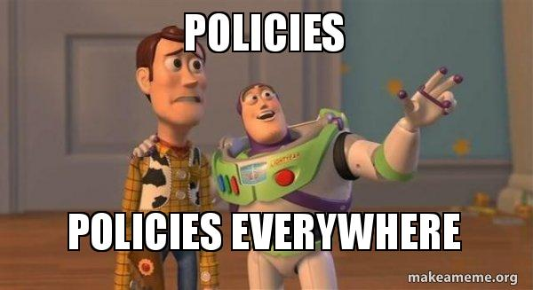
Policies
Religious Holidays
Accommodations
Academic Integrity
Stern Code of Conduct
Please check online syllabus for links and details

Slide 20
Generative AI Policy
What do you think?
You can use GenAI tools (but please use them smartly!)
We haven’t figured out yet how to best use these tools to teach coding
My advice: try and build things on your own, use GenAI to get you over stumbling blocks or humps.
Most important – use it as a learning tool! Use it as a way to dig deeper into certain tasks – I would love to hear about how you use it effectively
Good way to bump your Participation grade ☺

Slide 21
Class Schedule

